Slide 1
Android programming Dr. Xiaohong (Sophie) Wang

Slide 2
Getting Started
What is Android and how is an app built?
Android Studio
Exercise 1: Build a Hello world! app
App components: Views and ViewGroups
Exercise 2: Build a Beer Finder app
Model-View-Controller Architecture
Exercise 3: Build a Multiply Calculator app using MVC
Five tips for starting out

Slide 3
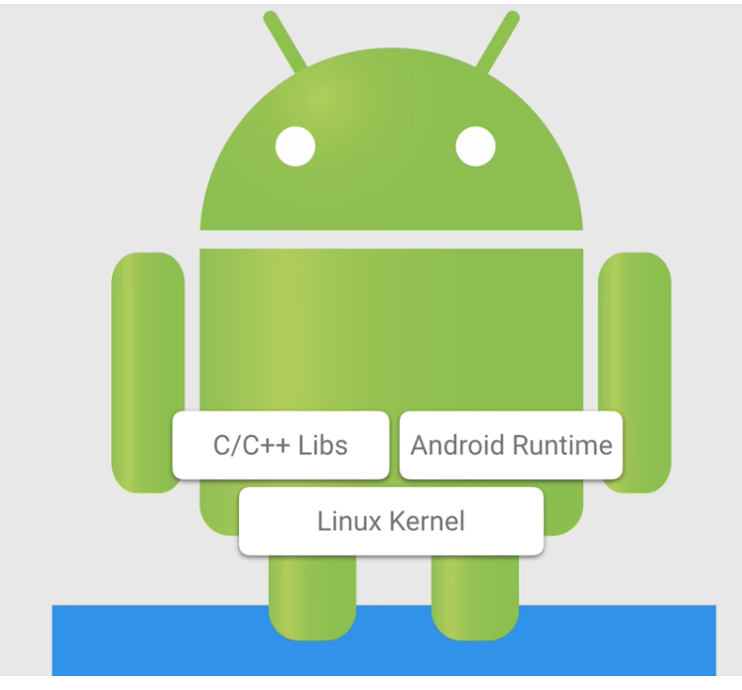
What is Android?
Android is a full software stack mobile operating system.
Its base is a Linux kernel that handles low level tasks like hardware, drivers and power management.
Android includes core C/C++ libraries like LibsC and SQLite.
Android contains an application run time environment.

Slide 4
Android Platforms
1st generation Android phones released in 2008
Since then, it has been enhanced in:
performance,
GUI design
many features
By 2015, it applications were including
fluid animations
bold color palettes
sophisticated multitasking menus

Slide 5
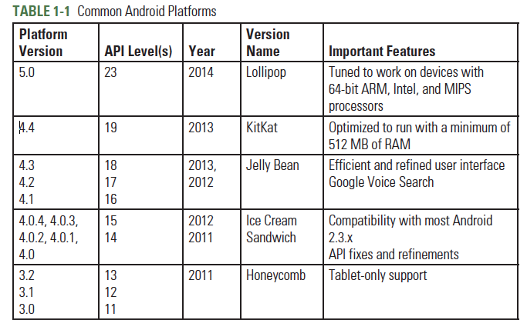
Evolution of Android

Slide 6
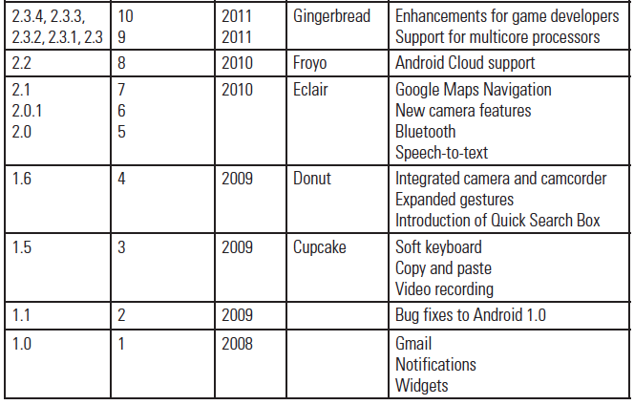

Slide 7
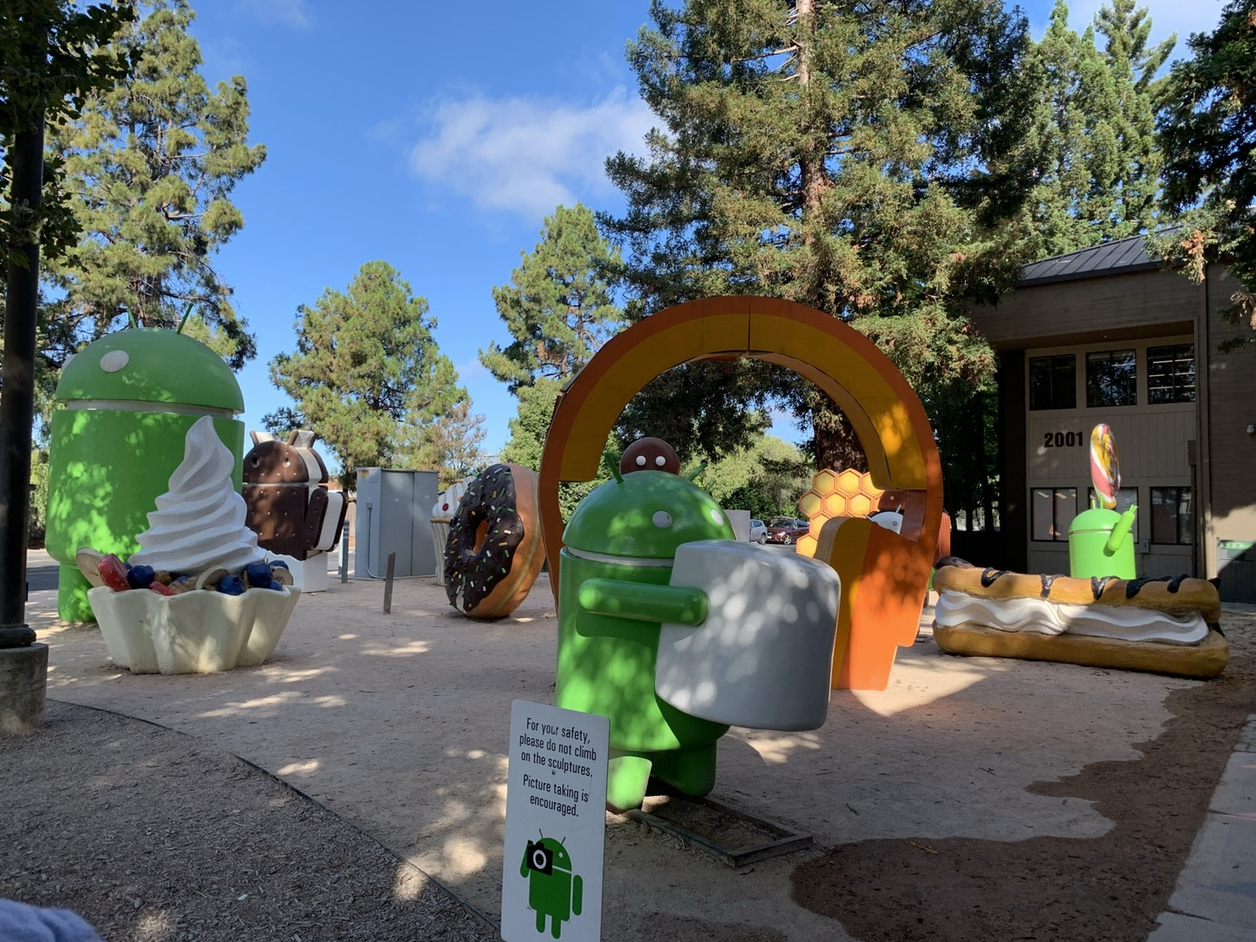
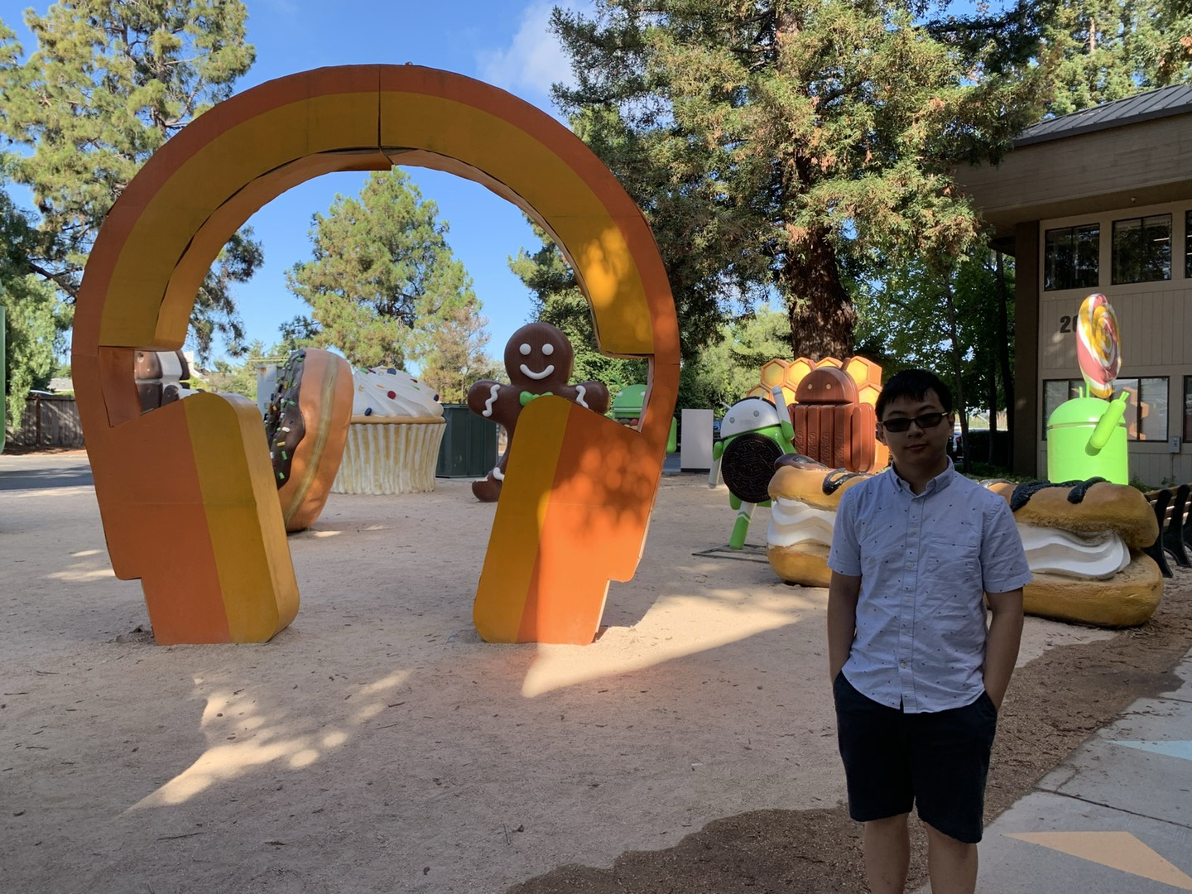

Slide 8
Google services were part of the Android operating system since the beginning
Two of the most substantial inclusions of Android 1.0 were Google Maps and Notifications
Notifications remains an important part of the Android user interface
In current releases, this feature has been refined to include chat messages and calendar events that support synchronization across all Android devices

Slide 9
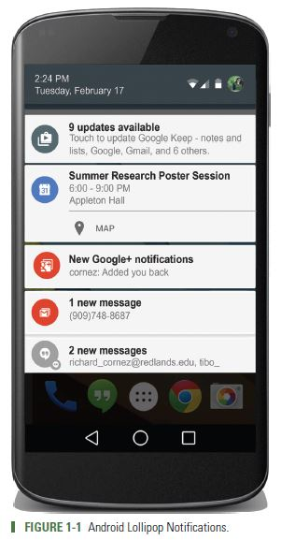

Slide 10
By the time Cupcake, refinements include:
self-refreshing widgets
copy-and-paste
a soft keyboard, which also brought the first forms of keyboard skins

Slide 11
Keyboard skins are created by third-party developers to provide enhancements to an existing soft keyboard
Unique to Android, skins allow users to personalize their keyboard
Skins have evolved alongside Android and have shifted beyond basic appearance and into more extensive behavior than originally seen in Cupcake

Slide 12
Android 2.2 with the ability to execute far faster
the new Dalvik Just-In-Time (JIT) compiler, first seen on Froyo
Dalvik allowed for better CPU performance, which significantly enhanced processing power
Froyo’s browser came with a new JavaScript engine, making Internet browsing nearly three times faster
Froyo also brought native support for tethering

Slide 13
Gingerbread is the first version of Android that backed multicore processing on mobile devices
support for new technologies, such as NFC (Near Field Communication), and SIP (Session Initiation Protocol)
The SIP API provides tools to create applications that perform video conferencing and instant messaging

Slide 14
Honeycomb was released as the first version of Android specifically implemented for tablets
Prior to Honeycomb, Android tablets were running on phone operating systems that were stretched to fit the screen of a larger tablet

Slide 15
Jelly Bean was a jump in magnitude of performance
was often referred to as a turning point for Android, where services and customization options met responsive design guidelines
Google Voice Search feature
Lollipop is the latest version
Lollipop and 64-bit chips provide enhanced performance with graphics, decoding and encoding of high-resolution video, and algorithms for facial recognition and speech interaction

Slide 16
Java vs. Android Java
A large number of Java libraries are available in the Android platform
The SDK includes a debugger, software libraries, and an emulator for an Android device

Slide 17
Java API vs the Android API
There is NO JVM in the Android platform
Dalvik is a specialized VM
Once Java has been compiled into bytecode by the Java compiler, it is compiled again into a proprietary bytecode
Bytecode loaded by the Dalvik VM should not be confused with Java bytecode
The dex bytecode is a compact Dalvik executable format designed for Android systems
which are constrained in terms of memory & CPU speed
The Android SDK includes the Dalvik dx tool, used to translate Java bytecode into Dalvik bytecode

Slide 18
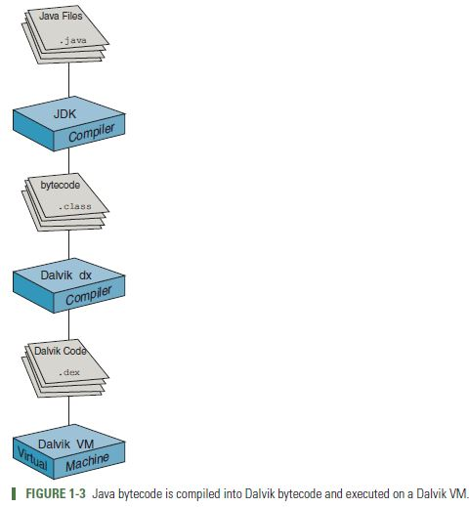

Slide 19
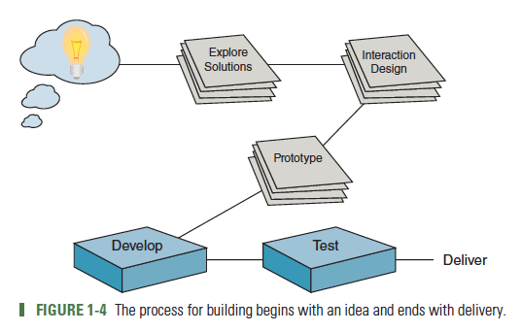
Basics of App Design
The process for building an application

Slide 20
Android Studio
Android Studio is IDE for Google's Android operating system.
It is built on Jet Brains' IntelliJ IDEA and designed specifically for Android development.
It is available for download on Windows, Mac OS and Linux based OS.

Slide 21
Anatomy of an Android Project
Project structure is organized by source code, the application’s resources, manifest settings, and build files
All of these files are eventually packaged into an apk file

Slide 22
Java Editor
Layout Editor
Android SDK
Android SDK Archive
AVD
Gradle

Slide 23
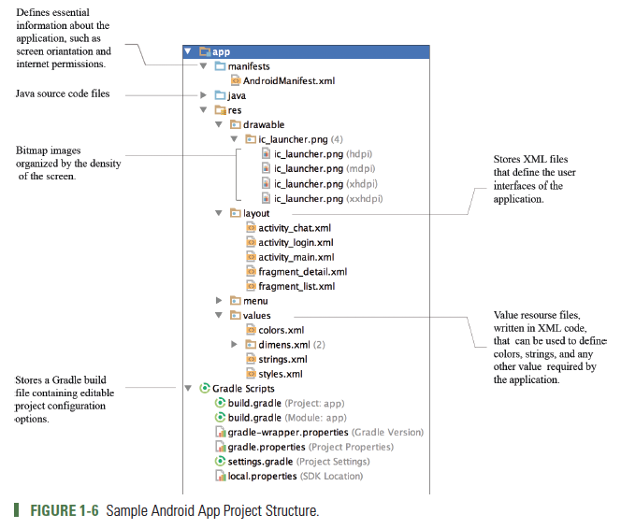

Slide 24
1.5.1 Android Manifest File
AndroidManifest.xml is required
it uses XML code to define specific application information
the application’s style and launch icon

Slide 25
1.5.2 Java Source Code and Activity Class Files
The Java source code of an application is placed in the java directory of the project structure
A main file, MainActivity or sometimes MyActivity, is a java file

Slide 26
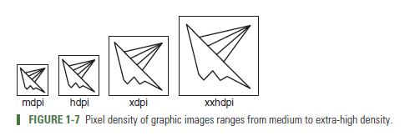
1.5.3 Drawable Resources
res contains the application resources
The drawable folder is located in the res directory
Drawable resources are image files,
such as application icons, buttons, and background textures

Slide 27
Generalized Screen Sizes
xlarge screens are at least 960dp x 720dp
large screens are at least 640dp x 480dp
normal screens are at least 470dp x 320dp
small screens are at least 426dp x 320dp

Slide 28
1.5.4 Layout XML files
User interface screens are visually designed and coded as XML layout files
The design and arrangement of the elements on the screen are implemented using XML code in a layout file

Slide 29
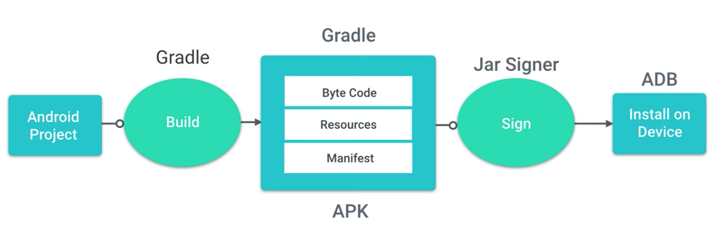
How is an Android App built and placed on a device?

Slide 30
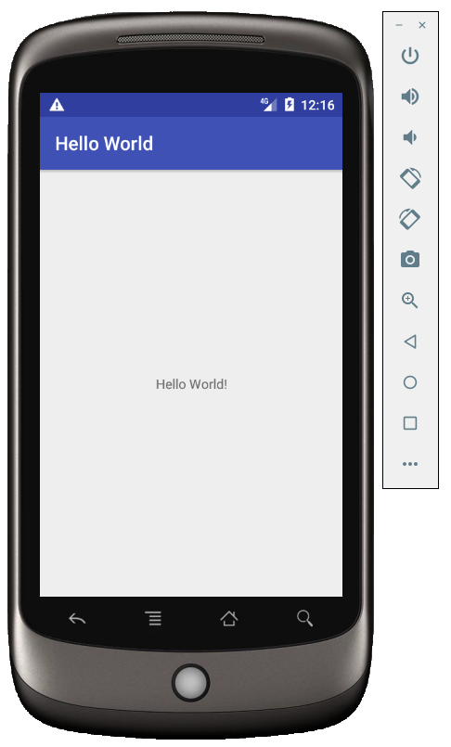
Exercise 1: Build A hello world app.
This application displays “Hello World!” in a textview.

Slide 31
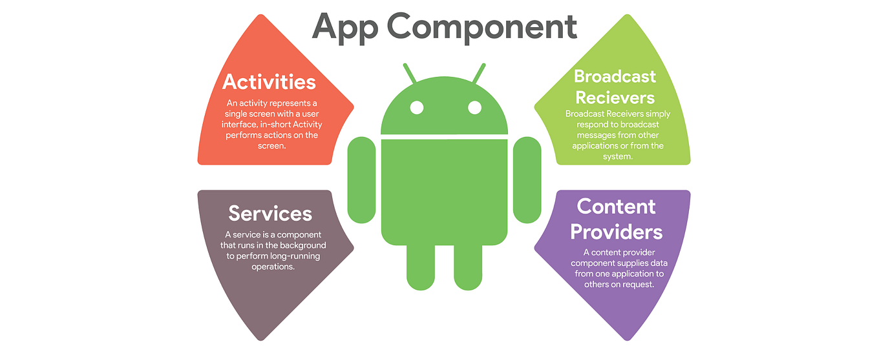
Components for an Android App?

Slide 32
Views in an Android Development
When creating an Android app, one or more interface screens must be generated using Views.
The building blocks of all interface screens are Views.
A View class is a super class that describes a general visual interface component.
A view is a rectangle on the screen that shows some content.

Slide 33
Example of an Interface Screen
A View has a width and a height.
It may have a background color.
The interface screen example shows Views of three different types:
Image
Text
Button

Slide 34
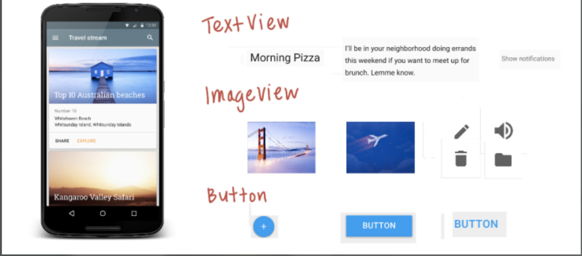
Most Common View Objects
A Button can be a TextView that is touch sensitive.
A Button can also be an ImageView that is touch sensitive.

Slide 35
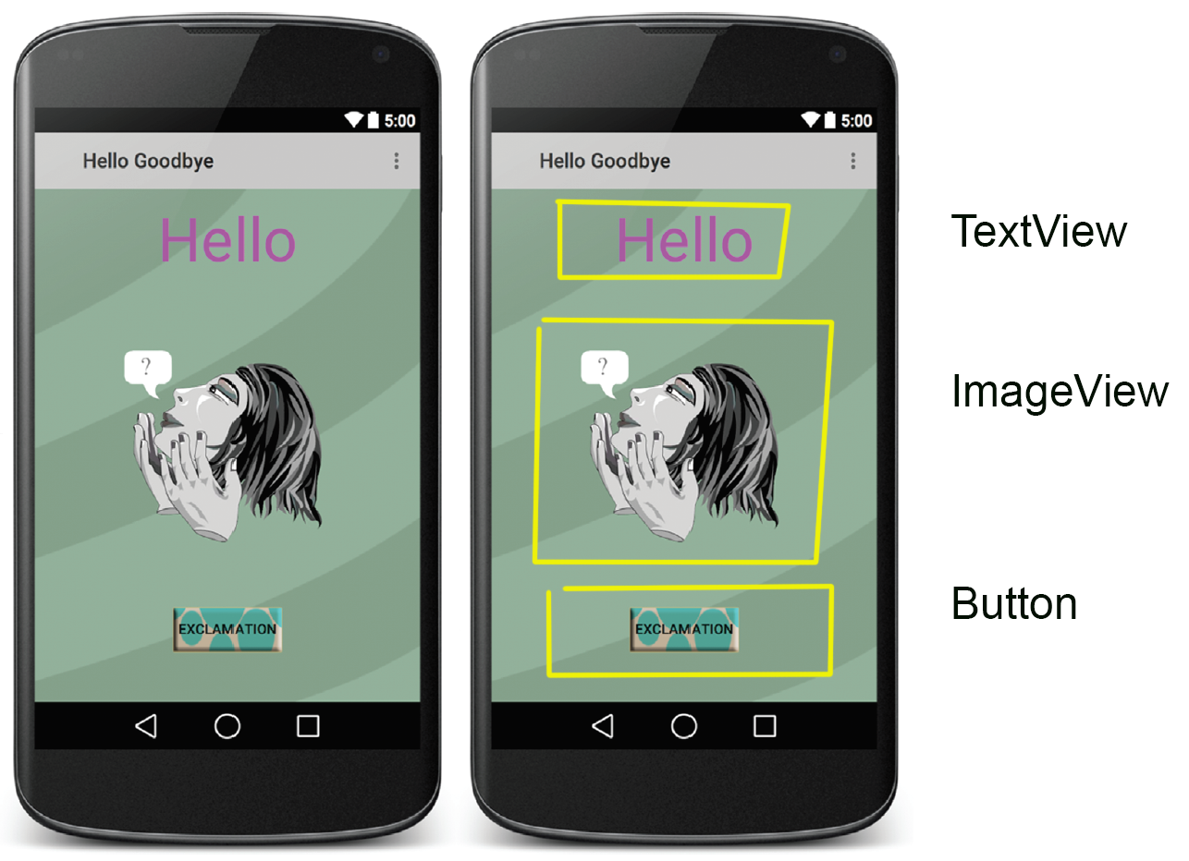
Interface Screens and Views
The Interface Screens in every app can be broken down into the individual Views.

Slide 36
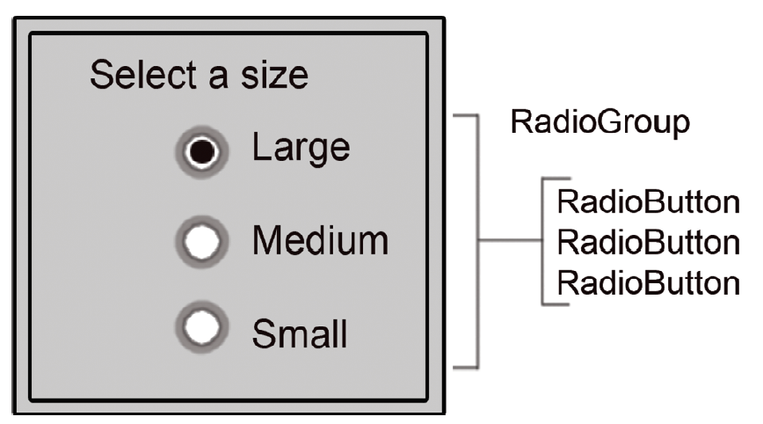
ViewGroup
A ViewGroup is another type of View.
Specifically, a ViewGroup is a View container.
It is used to hold and position smaller Views.
Common ViewGroups :
RadioGroup : Designed to hold related RadioButtons.
ConstraintView: allows you to position and size elements in a flexible way.
Linear Layout: designed for a linear arrangement of View objects
RelativeLayout: used to place View objects in relation to each other.

Slide 37
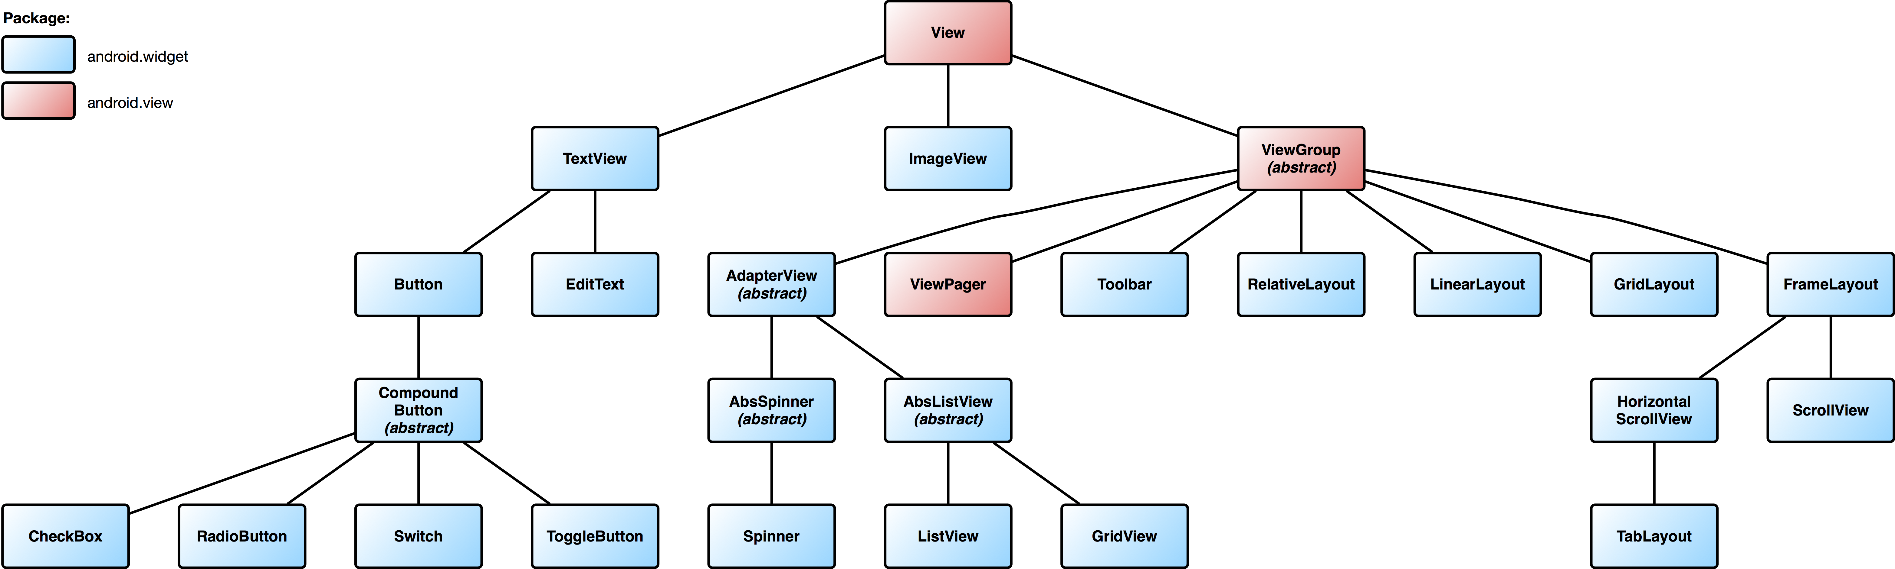

Slide 38
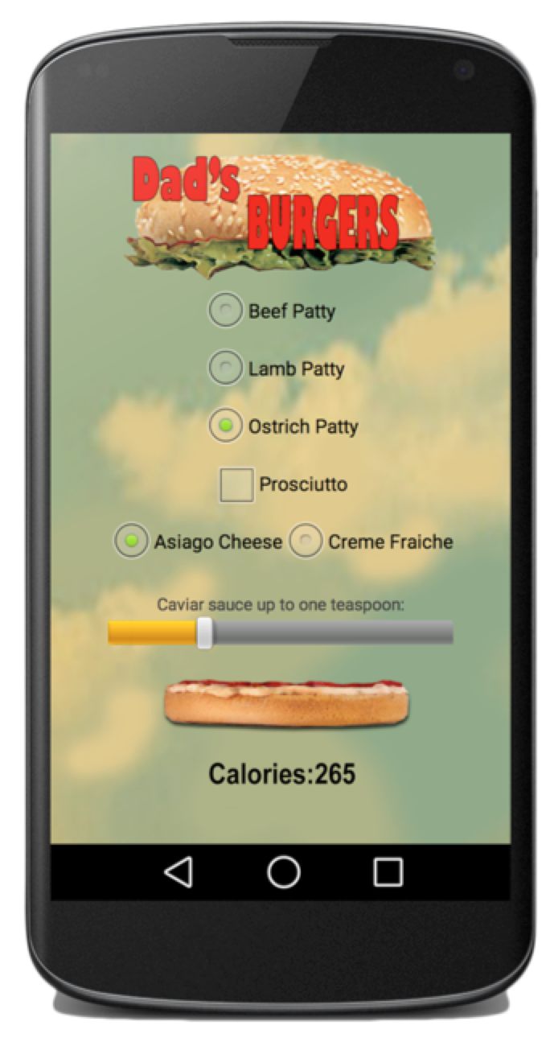
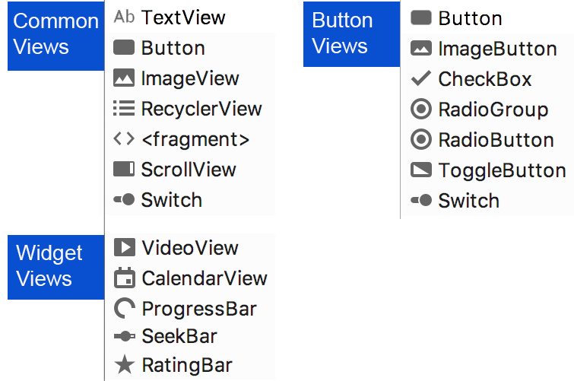

Slide 39
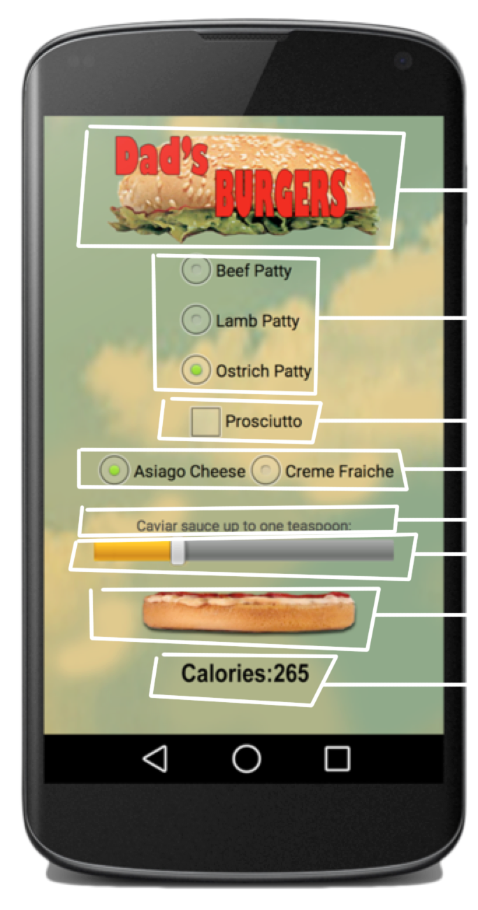
ImageView
RadioGroup contains three RadioButtons
CheckBox
RadioGroup contains two RadioButtons
TextView
SeekBar
ImageView
TextView

Slide 40
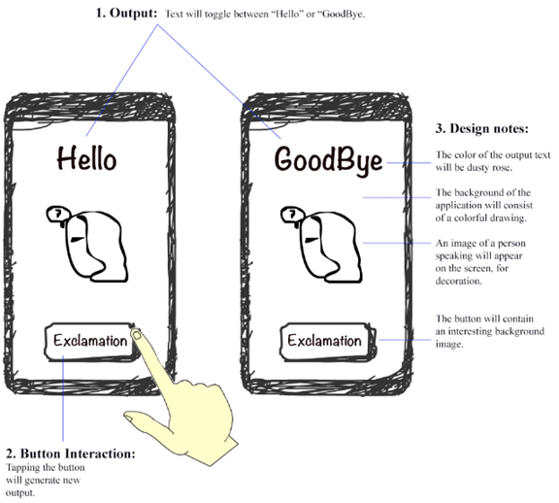

Slide 41
Activity_main.xml

Slide 42
MainActivity.java

Slide 43
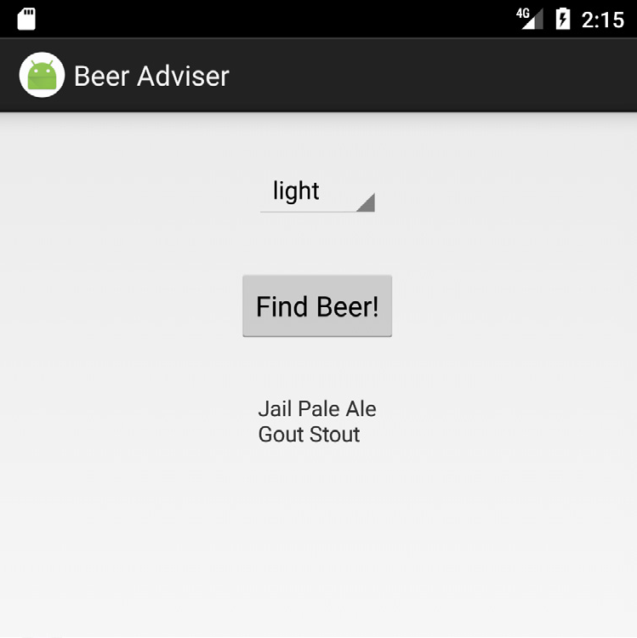
Exercise 2: Build Beer finder app.
This application recommend beer for people depending on their choices based on Chapter 2 of Head First Android Development Page 37-73

Slide 44
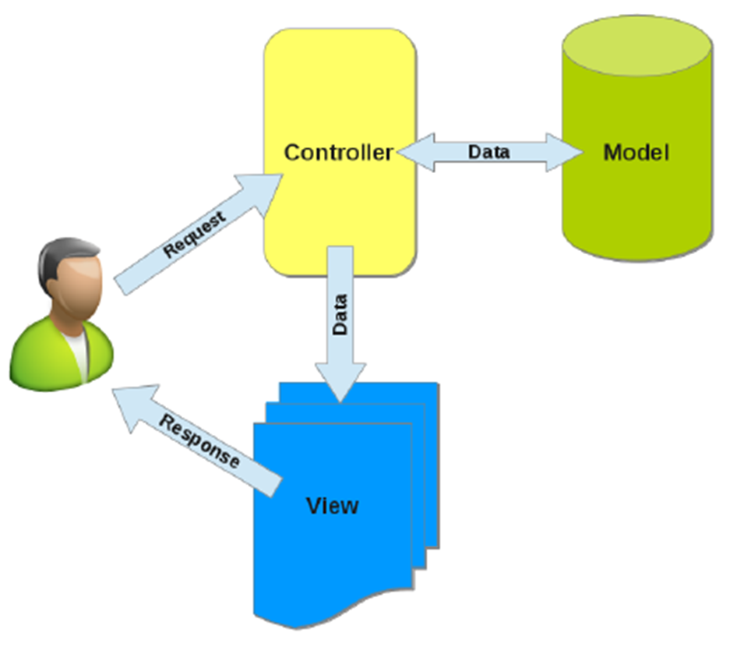
Model-View-Controller (MVC) Architecture
Mobile applications rely on the MVC architecture.
App objects are assigned one of three roles: Model, View, or Controller.
Mobile apps have one important rule governing how objects communicate with each other.
Example: A background thread cannot communicate with a View object

Slide 45
The Model
The Model handles the data in an App.
The Model does not care how its data will be displayed or when it will updated.

Slide 46
The View
A View component is the visual presentation of data in an App.
Example: a TextView is a View object that displays text data on the App interface screen.
Users interact using Views.
Example: TextView and Button are View objects that users can respond to with actions.

Slide 47
Controller Object
A Controller object acts as an intermediary between View components and Model objects.
The Controller can request that data be updated within a Model.
The Controller can also update the display data shown in the View.

Slide 48
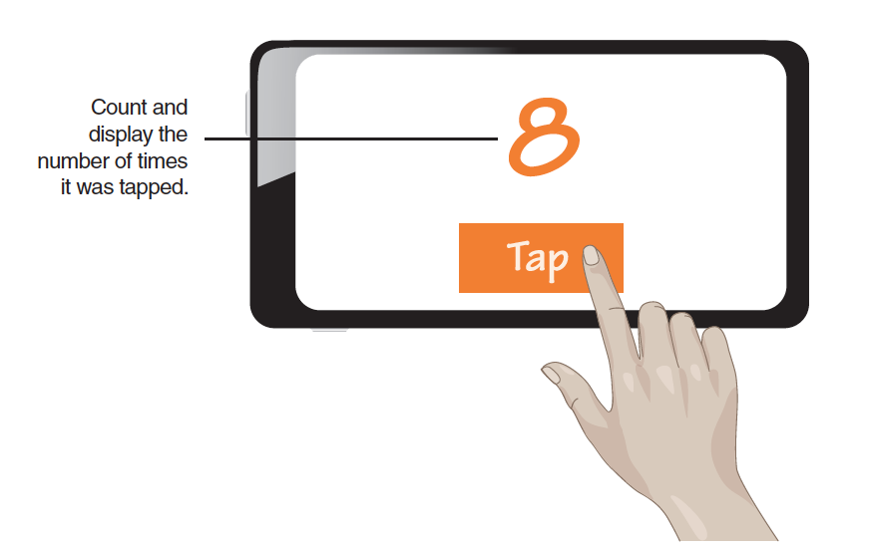
Exercise 3: Build A Count app using MVC.
The Controller will intercept the Tap button event, communicate a new increment data to the Counter data object, and update the TextView in the user interface.

Slide 49
MVC Architecture for Tap App
Controller: Java code that acts as the conduit between the Counter (Model) and UI Components (Views)
Model: Java class that keeps track of Counter data.
View: TextView (to display the count) and Button (to register a tap).

Slide 50
Android Structure for Tap App

Slide 51
Model: Counter.java
public class Counter { private int mCount; public Counter(){ mCount = 0; } public void addCount(){ mCount++; } public Integer getCount() { return mCount; } }

Slide 52
View: main_layout.xml
<?xml version="1.0" encoding="utf-8"?> <RelativeLayout
xmlns:android="http://schemas.android.com/apk/res/android" android:layout_width="match_parent" android:layout_height="match_parent"> <TextView android:layout_width="wrap_content" android:layout_height="wrap_content" android:textAppearance="?android:attr/textAppearanceLarge" android:text="0" android:id="@+id/textView" android:layout_alignParentTop="true" android:layout_centerHorizontal="true" android:textSize="60sp" />
<Button android:layout_width="wrap_content" android:layout_height="wrap_content" android:text="TAP" android:id="@+id/button" android:layout_centerVertical="true" android:layout_centerHorizontal="true" android:textSize="60sp" android:onClick="countTap" /> </RelativeLayout>

Slide 53
Controller: MainActivity.java

Slide 54
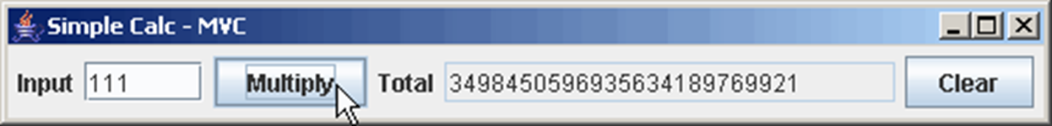
Exercise 3: Build A Multiply Calculator using MVC
Implement an Android version of the following app. Please refer to the Java standalone version of the application here:
https://faculty.salisbury.edu/~xswang/Courses/csc330/Lecture/MVC.ppt

Slide 55
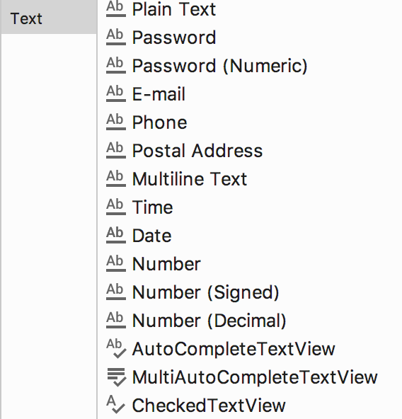
EditViews

Slide 56
Tips for Starting Out
#1
When creating a new Android App, Choose “Empty Activity” from the dialog window.
This will produce the default starter code files that you need.

Slide 57
Tips for Starting Out
#2
Use a cable to connect your phone to your computer.
This will be faster and far easier than using the emulator.

Slide 58
Tips for Starting Out
#3
Your phone must configured so that you can develop on it.
This is done by clicking the build number (found in settings/About Phone) 7 times.
Within “Developer option”, choose USB debugging.
This will allow your computer to put applications onto your phone.

Slide 59
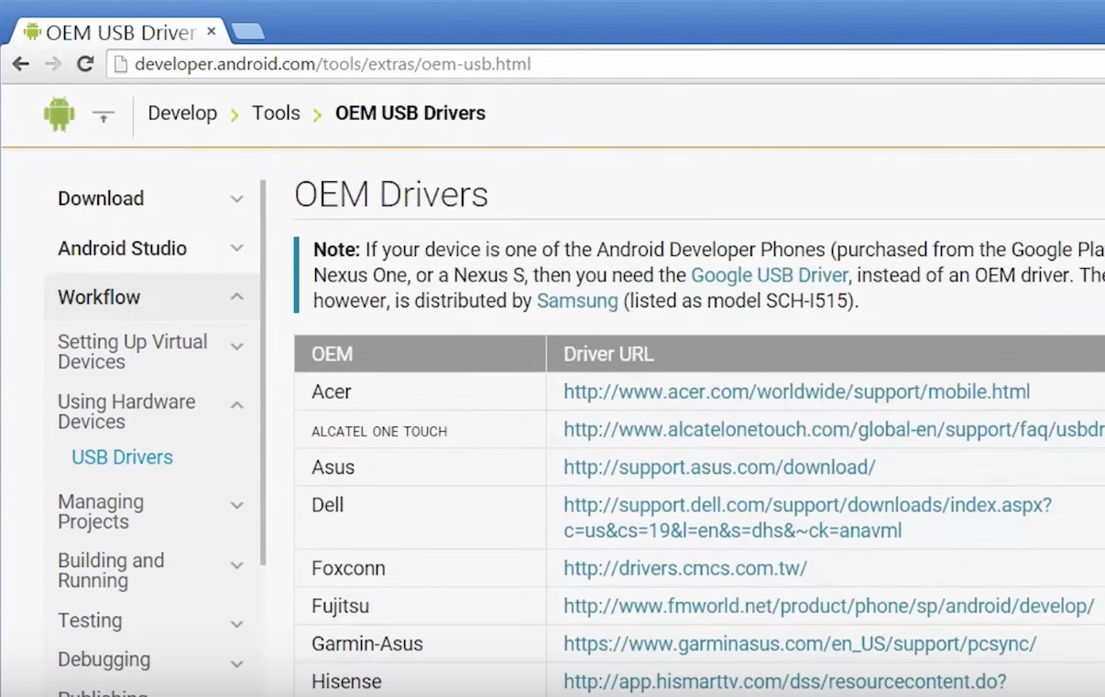
Tips for Starting Out
#4
If you are using Windows, your computer needs a driver to communicate with your phone.
Download the driver by Googling (oem Android) Original Equipment Manufacturers.
Locate the appropriate driver and download it.

Slide 60
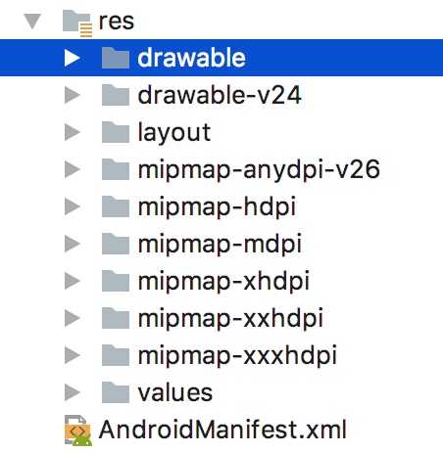
Adding Images to a Project
Tips for Starting Out
#5
Right-click Drawables.
Open the folder by selecting one of the following
Reveal in Finder (Mac)
Showin Explorer (Windows)
Drag images to the Drawables folder.

